Slide 1
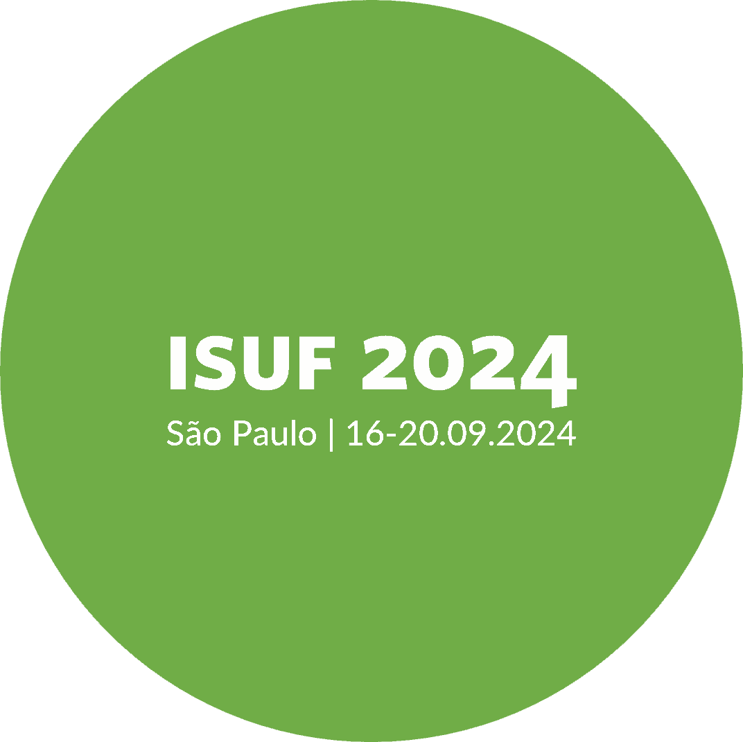
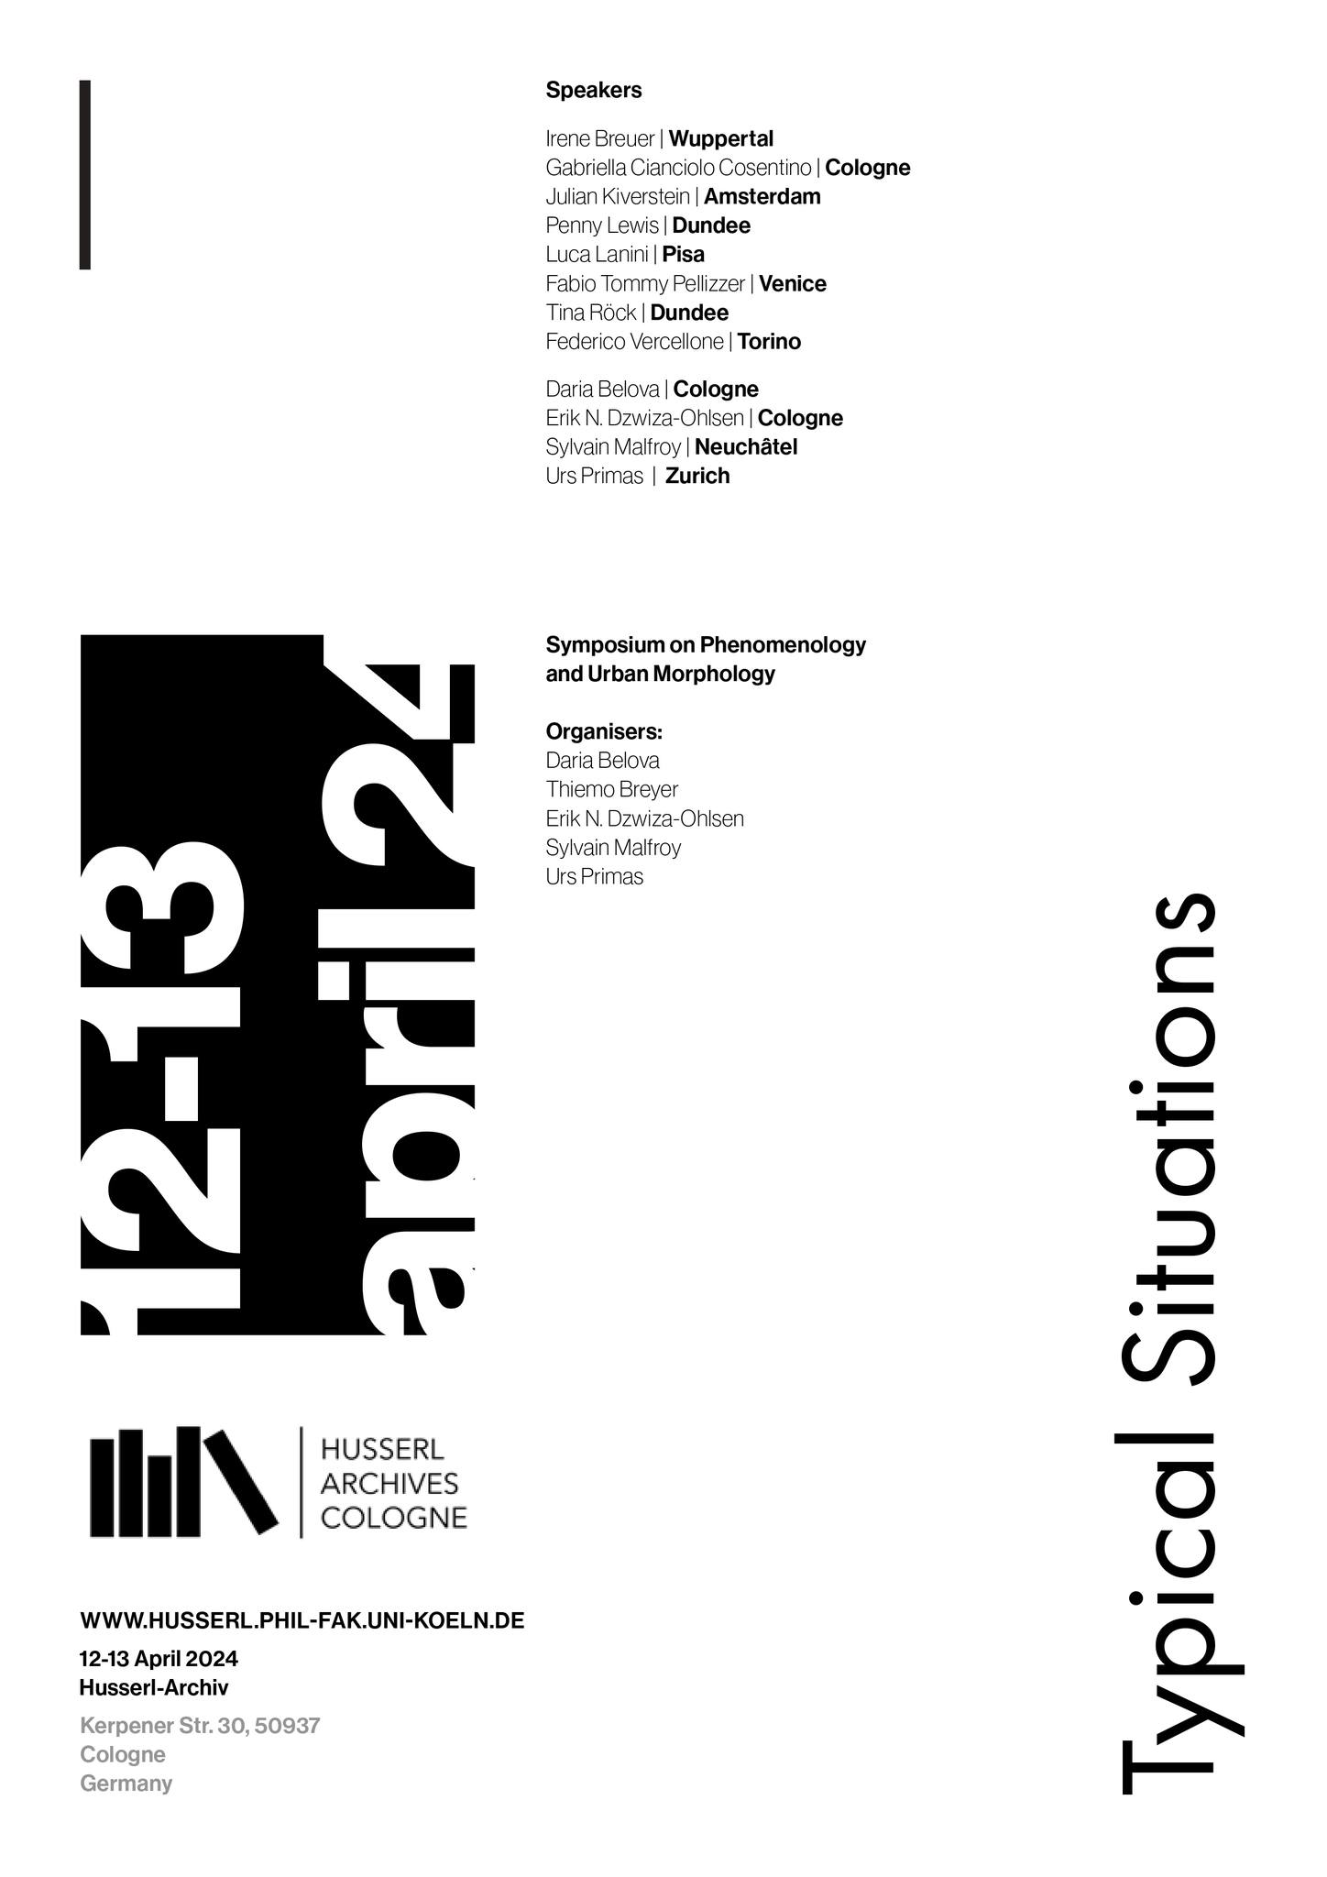


THE ROLE OF TYPIFICATION IN PHENOMENOLOGY AND URBAN MORPHOLOGY
Dr. Daria Belova¹, Dr. Prof. Sylvain Malfroy², Dr. Erik Norman Dzwiza-Ohlsen³, Urs Primas⁴
¹Visiting researcher (Husserl Archives Cologne, Faculty of Arts and Humanities, University of Cologne), Germany,
dariia.belova@gmail.com
² Former Professor (Institute Urban Landscape, Department of Architecture, Zurich University of Applied Sciences) Switzerland, sylvain.malfroy@bluewin.ch
³Researcher (Husserl Archives Cologne, Faculty of Arts and Humanities, University of Cologne), Germany, edzwiza@uni-koeln.de
⁴Lecturer (Institute for Urban Landscape, Department of Architecture, Zurich University of Applied Sciences), Switzerland, prim@zhaw.ch
INTERNATIONAL SEMINAR ON URBAN FORM

Slide 2
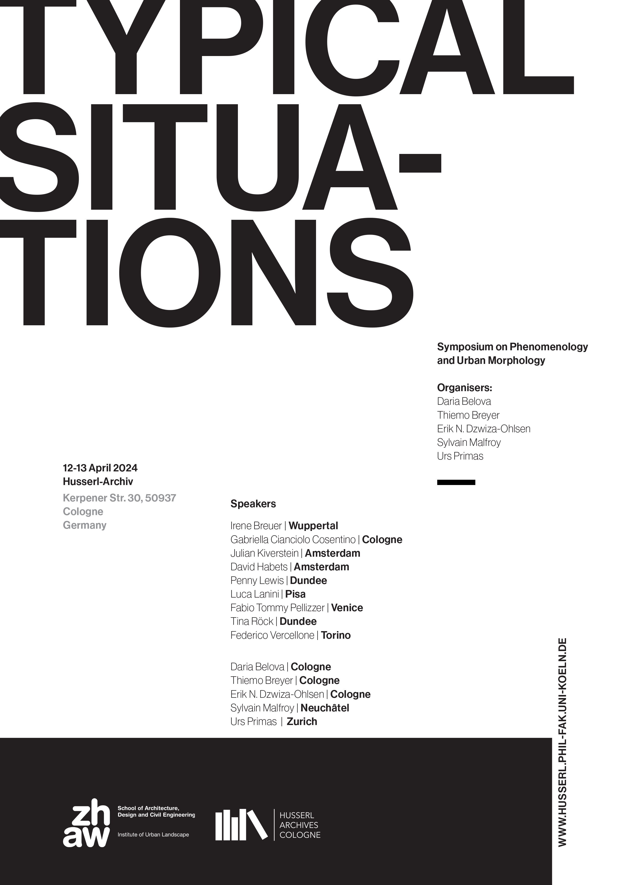
Notes:
The world we live in is manifold, full of surprises, and constantly changing. Fortunately, it also offers a range of recurring and typical situations, thereby enabling us not to get lost, to experience the novel through the lens of the familiar and hence to develop a sense of feeling at home in the world. As a newly formed team with a common interest in phenomenology, urban morphology and well-being, in this workshop we aimed to sharpen our understanding of the underlying notion of type as a fundamental structural property of the human lifeworld from complementary perspectives: urban morphology, architecture and heritage studies on the one hand; philosophy, phenomenology, and research on experience and artefacts on the other. This complementary perspective on type and typical situations and the associated terms, concepts and topics was at the heart of this workshop.
The two-day event “Typical Situations” was an inter- and transdisciplinary workshop to foster the dialogue between urban morphology and philosophy. It took place at the Husserl Archives Cologne from the 12 to the 13 April 2024 and was collaboratively organised by Daria Belova, Thiemo Breyer, Sylvain Malfroy, Erik Norman Dzwiza-Ohlsen and Urs Primas.

Slide 3

RESEARCH QUESTION AND TOPIC
Typical elements, forms and patterns are the basis for many morphological approaches. Their transformations with reference to types reflect culturally significant characteristics.
The role of typification in human cognition and experience has been underdeveloped within the modern research background of architecture and urban studies in general, and urban morphology in particular.
Phenomenology uses the concept of type to denote a fundamental structuring element of human experience.
The workshop united Phenomenology and two of approaches in Urban Morphology: Typological-Processual and Configurational.
Notes:
The study of typical situations in buildings and in the city was a central contribution of Italian architects and urban researchers in the second half of the twentieth century. Subsequently, this line of inquiry has influenced the debate and production of architecture and urbanism in many places. Meanwhile, the related question of the role of typification in human experience has been underdeveloped within the modern research background of architecture and urban studies in general, and urban morphology in particular. The tradition of urban form studies, or urban morphology, links architecture, urban history, planning and design through form, uniting a vast and growing community of researchers originally coming from such diverse disciplines as architecture, urban design, geography, history, anthropology, heritage studies and so on. The field encompasses several complementary approaches that are collaborating within the framework of the International Seminar on Urban Form (ISUF). One of them is rooted in the method of process-based typology founded by the Italian architect Saverio Muratori and has been further developed, among others, by Gianfranco Caniggia. It stands apart from other typological approaches in its emphasis on process and the history of the development of local urban palimpsests, which is particularly attuned to historical and cultural context. Another approach striving to link urban morphology to the phenomenology of human spatial perception is Space Syntax. This configurational approach to the study of urban form has been developed in the 1970s by Bill Hillier, Julienne Hanson and colleagues at the Bartlett, University College London. It examines the relationship between human behaviour and spatial configurations, comparing patterns of activity with patterns of space.

Slide 4
MERGING EXPERIENCE AND URBAN FORM
Phenomenology provides an understanding of the human experience of the world that is methodologically rigorous, it focuses on the structures of lived experience.
Phenomenology of architecture offers comprehensive in-depth investigations of fundamental concepts in architecture, such as space and place, dwelling, building and atmospheres, embodiment, environment and lifeworld, actions, affordances, and of design elements such as corners, edges, and surfaces, or lines, rectangles, and frames, and so on. The experience of the lifeworld, or our home-world, is shaped by elements including perception, movement, perspectivity, orientation, familiarity, historicity, and so forth.
Typicality and habituality are profoundly relevant to urban morphology as they have a strong influence on how we perceive, interact with and inhabit our built environments.
Notes:
Phenomenology provides an understanding of the human experience of the world that is methodologically rigorous, it focuses on the structures of lived experience. The phenomenology of architecture offers comprehensive and in-depth investigations of the most fundamental concepts, terms and ideas in architecture, such as space and place, dwelling, building and atmospheres, embodiment, environment and lifeworld, actions, affordances, and of design elements such as corners, edges, and surfaces, or lines, rectangles, and frames, and so on. The experience of the lifeworld, or more precisely, of our home-world, is shaped by elements including perception, movement, perspectivity, orientation, familiarity, historicity, and so forth. The concepts of typicality and habituality are profoundly relevant to urban morphology as they have a strong influence on how we perceive, interact with and inhabit our built environments. Morphology is largely based on the recognition and study of typical elements, forms and patterns, as well as their transformations with reference to types that embody culturally significant characteristics.

Slide 5
INTERESTS AND DISCIPLINES
In the workshop, starting from typification in phenomenology and morphology, we went further:
phenomenology and philosophical anthropology; applied phenomenology with a focus on orientation, embodiment and ageing; phenomenology of architecture; architectural history; philosophy with a focus on metaphysics and ontology; affordances and landscape architecture; European avant-garde and architectural typology; terminology in morphology; phenomenological psychology; cognitive science; typological-processual as well as configurational approaches to urban morphology, etc.
Experts in philosophy, anthropology, enactivism, landscape architecture, urban planning and design, architecture, psychology, architectural history, and literature were building bridges between disciplines.
Notes:
The workshop brought together participants from different research cultures and disciplines related to philosophy and architecture, such as phenomenology, anthropology, enactivism, landscape architecture, urban planning and design, architectural history, and literature.
The interests of the participants covered a wide range of topics and areas, including but not limited to phenomenology and philosophical anthropology; applied phenomenology with a focus on orientation, embodiment and ageing; phenomenology of architecture; architectural history; philosophy with a focus on metaphysics and ontology; affordances and landscape architecture; European avant-garde and architectural typology; terminology in morphology; phenomenological psychology; cognitive science; typological-processual as well as configurational approaches to urban morphology.

Slide 6
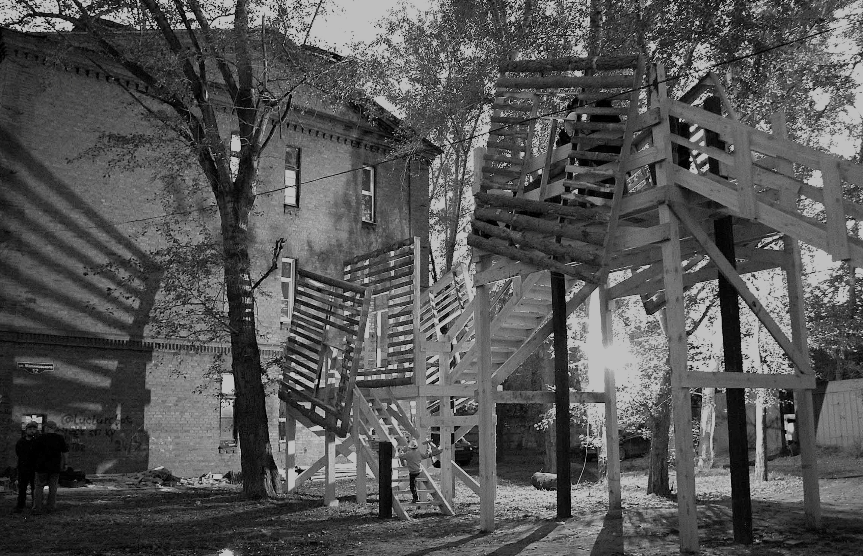
PRESENTATIONS
BRIDGING PHENOMENOLOGY AND URBAN MORPHOLOGY: THE CASE OF SITUATIONAL TYPIFICATION
Erik N. Dzwiza-Ohlsen & Daria Belova
Typo-morphology and Phenomenology understand types in a dynamic way, involving processes of foundation, sedimentation and reactivation.
Situational typification in Husserl lies at the intersection of materiality with human action, perception and affection.
Typification should include material and immaterial forms.
Notes:
Therefore, and according to the following presentation by Daria Belova, architect, and Erik Dzwiza-Ohlsen, philosopher (both researchers at the Husserl Archives Cologne), situational typification lies at a crucial intersection of materiality with human action, perception and affection. Both urban morphology and Husserlian phenomenology understand types in a dynamic way, involving processes of foundation, sedimentation and reactivation. Urban morphology does address the socio-cultural dimension of typical situations, albeit indirectly, through an investigation of invariant structures and typical processes underlying urban form. To this, the investigation of invariant structures of lived experience offered by phenomenology constitutes a fitting and necessary counterpart, especially when it comes to the persistent challenge of linking the individual-centered perspective of the micro-scale to the societal and institutional perspective of the macro-scale.

Slide 7
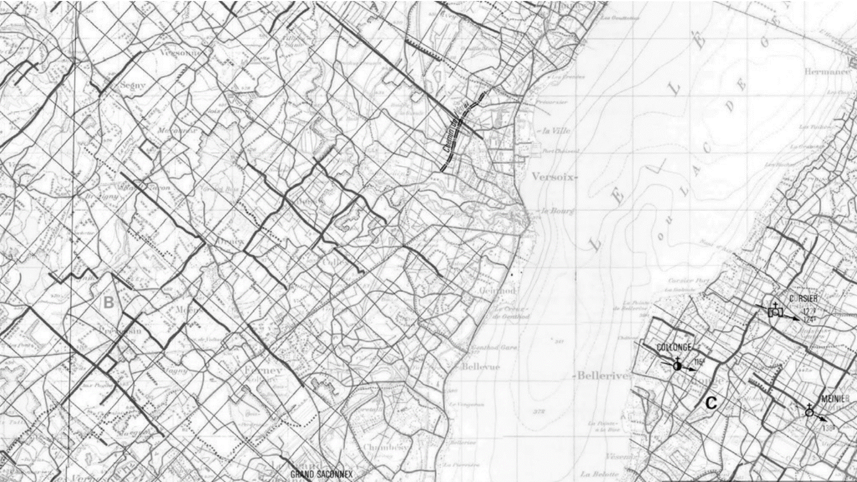
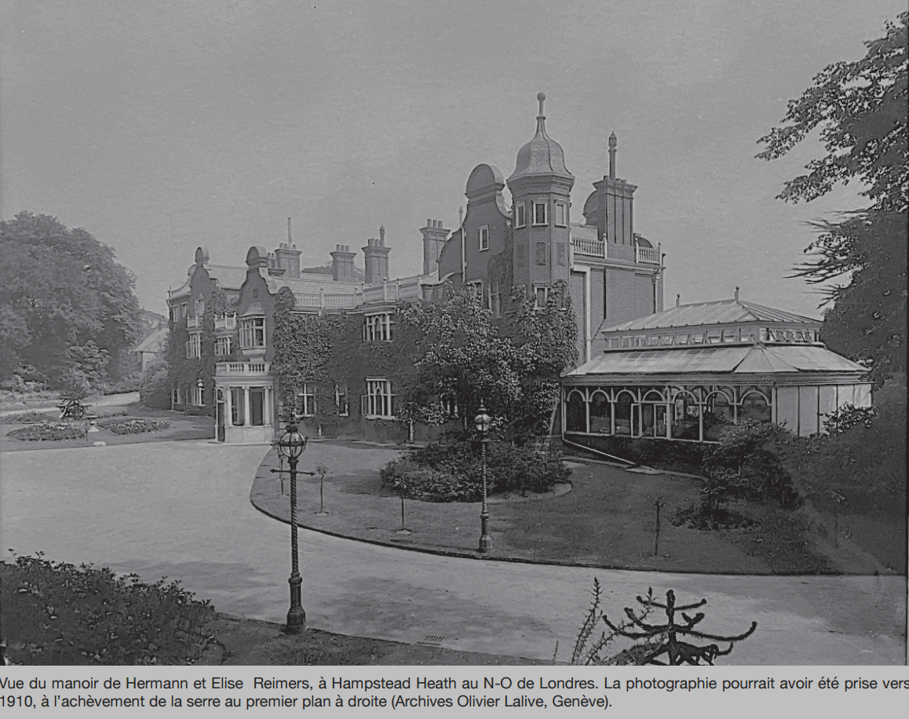
PRESENTATIONS
SITUATIONS: WHAT THEY DO WITH US AND WHAT WE DO WITH THEM. ABOUT AGENCY AND STRUCTURAL TENDENCIES. Sylvain Malfroy
.
To characterise a part that cannot exist outside a relevant whole, Husserl had introduced the notion of ‘moment’, as opposed to ‘piece’: the 'moment' is a property of a whole that cannot be detached.
Can a 'composite object’ or a whole survive the loss of a 'moment' as well as the loss of a 'piece’? In other words, the existence of things of a certain type is entirely based on certain ‘moments’, whereas the detachable parts, i.e., the material parts of it, can be largely interchangeable: the convergence between the morphology, the management of historical heritage and phenomenology.
Notes:
After these conceptual preliminaries, Sylvain Malfroy addressed the typification of emerging situations. By way of example, he dissected the historical process that gave shape to the Tournay estate on the outskirts of Geneva currently undergoing a trend towards the fragmentation of land ownership and the disarticulation of its original functional structure. To characterise a part that cannot exist outside a relevant whole, Husserl had introduced the notion of ‘moment’, as opposed to ‘piece’. Drawing on this distinction, Malfroy advocated an approach to changes of use and indices of constructability of land that is more attentive to the ‘moments’ that characterise each situation. In short, obsolete urban ensembles challenge us to make explicit the ‘moments’ and interdependent relationships that persist between different levels of scale: the politically crucial question is whether types of situations possess their own evidence, or whether they remain ultimately arbitrary.
As far as the study of part/whole relationships is concerned, which is required to deepen our understanding of the city both as an 'urban fabric' and as a 'large-scale composition', the conceptual pair 'moment' / 'piece' theorised by Husserlian philosophy is very enlightening (Barry Smith a. o. 1982; Malfroy 2014). Saverio Muratori had already drawn our attention to this when he proposed a method for measuring the 'degrees of organicity' that qualify an assembly of parts. In Husserl's Logical Investigations, the 'moment' is a property of a whole that cannot be detached (except by a process of abstraction). For example, in the case of a landscape garden, the typological character of "being landscaped" (rather than "being a kitchen garden") cannot be isolated from the garden, but can only be verified as a "moment" concretised in the choice of planting, in the determination of the garden's extent, in the layout of paths, in the treatment of boundaries and transition zones, and so on.
The possible and desirable convergence between the morphology of built forms, the management of historical heritage and phenomenology becomes immediately apparent when we ask ourselves whether a 'composite object' can survive the loss of a 'moment' as well as the loss of a 'piece'. This question is generally treated under the heading of the 'conditions of persistence' of artefacts (Haslanger a. o. 2006). If we halve the area that embodies the 'landscape moment' of a garden, we destroy it more surely than if we remove a fountain, a bench or an arbour that are 'pieces' of it. In other words, the existence of things of a certain type is entirely based on certain 'moments', whereas the detachable parts, i.e. the material parts of it, can be largely interchangeable. But a symmetrical issue to that of the conditions of persistence concerns the ‘conditions of emergence of artefacts of a new type’ (de Monticelli a. o. 2008). Indeed, it may be that when an object of a certain type (for example, an aristocratic country manor) is deprived of its constituent moments (for example, its pleasure grounds) and thus ceases to exist as such, objects of another type take its place (for example, a hospital or a tourist hotel). The question then arises as to whether there is a rationally elucidable genetic chain linking the initial type of manor house to the successive types of hospital or tourist hotel. In other words, was it more probable that one transformation would occur than another? Husserlian phenomenology is driven by a realist aim, and it endeavours to show that the substratum of our actions is not an inert, passive reality, but a structured reality with which we can collaborate more or less intelligently.
.

Slide 8
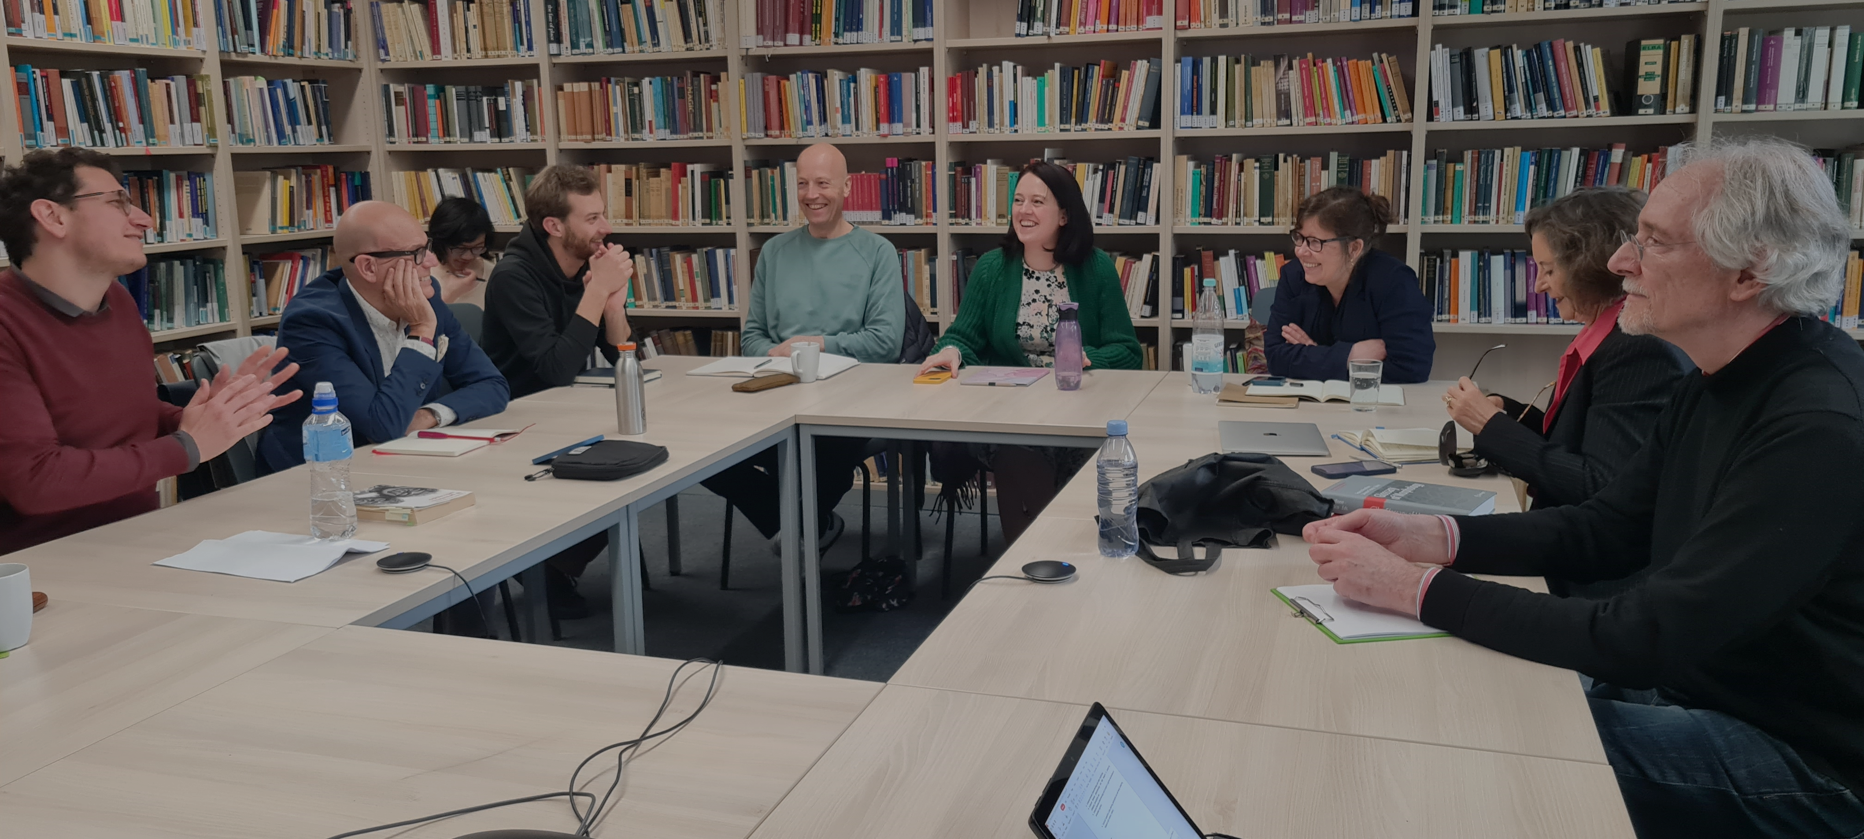
PRESENTATIONS
TYPES OF IDEAS AND ESSENCES – FROM BEING TO BECOMING
Tina Röck
The definitions of type can be divided into two ‘semantic clouds’, and a spectrum between.
The spectrum of definitions of the concept of type between ‘typical’ and ‘singular’ is also broad.
It can be studied how the choice of a certain concept of type defines architectures when the method is applied.
Notes:
Then, the time had come to shake things up by exposing the audience to the backside of what we had been looking at so far. This vital role of philosophy was taken on by Tina Röck (University of Dundee, UK) by means of a summary of Martin Heidegger’s critique of the Husserlian concepts of type and familiarity. Heidegger had been concerned by the ways in which immediate typification might prevent us from seeing what is actually present. Remaining within the comfort zone of the familiar, we all too easily limit ourselves to seeing how things surrounding us might serve our aims and needs. The related, crucial question of how to address the necessarily uncomfortable shift from a paradigm of understanding to a paradigm of action and change kept occupying the participants during the remainder of the symposium.

Slide 9
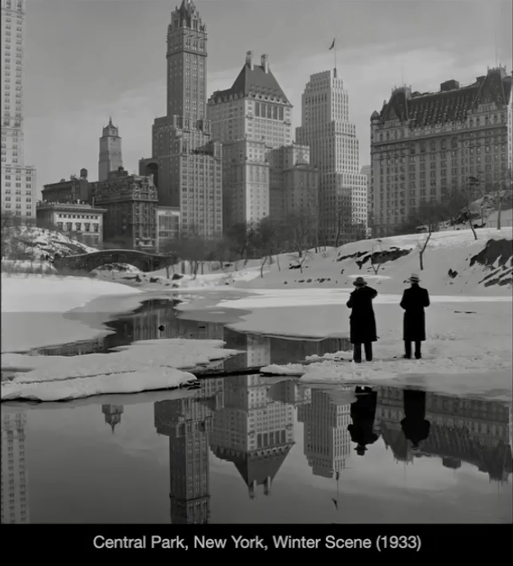
PRESENTATIONS
TRUSTED URBAN PLACES
Julian Kiverstein & David Habets
A concept crucial to the interplay between typical urban situations and human habits: basic trust. People habitually draw upon environmental resources to sustain, amplify or dampen affective states. The city turns into a constellation of “trusted places”.
From a joined phenomenological and architectural perspective, the historical, continuously formed city can be seen as a constellation of trusted urban places, which affect our bodies in a certain way, fostering basic trust.
Notes:
The next day started with the introduction of a concept that might turn out crucial to our understanding of the interplay between typical urban situations and human habits: basic trust. Referring to the notion of affective scaffolds in psychology, Julian Kiverstein (University of Amsterdam) and David Habets (Amsterdam Medical Center) showed how people habitually draw upon environmental resources to sustain, amplify or dampen affective states. In this way, habits may be understood as nested in places. The city turns into a constellation of “trusted places” that are visited because of the effects they have on our bodies. It becomes clear that these places are not “outside” of us: rather, our very existence is rooted in them.

Slide 10
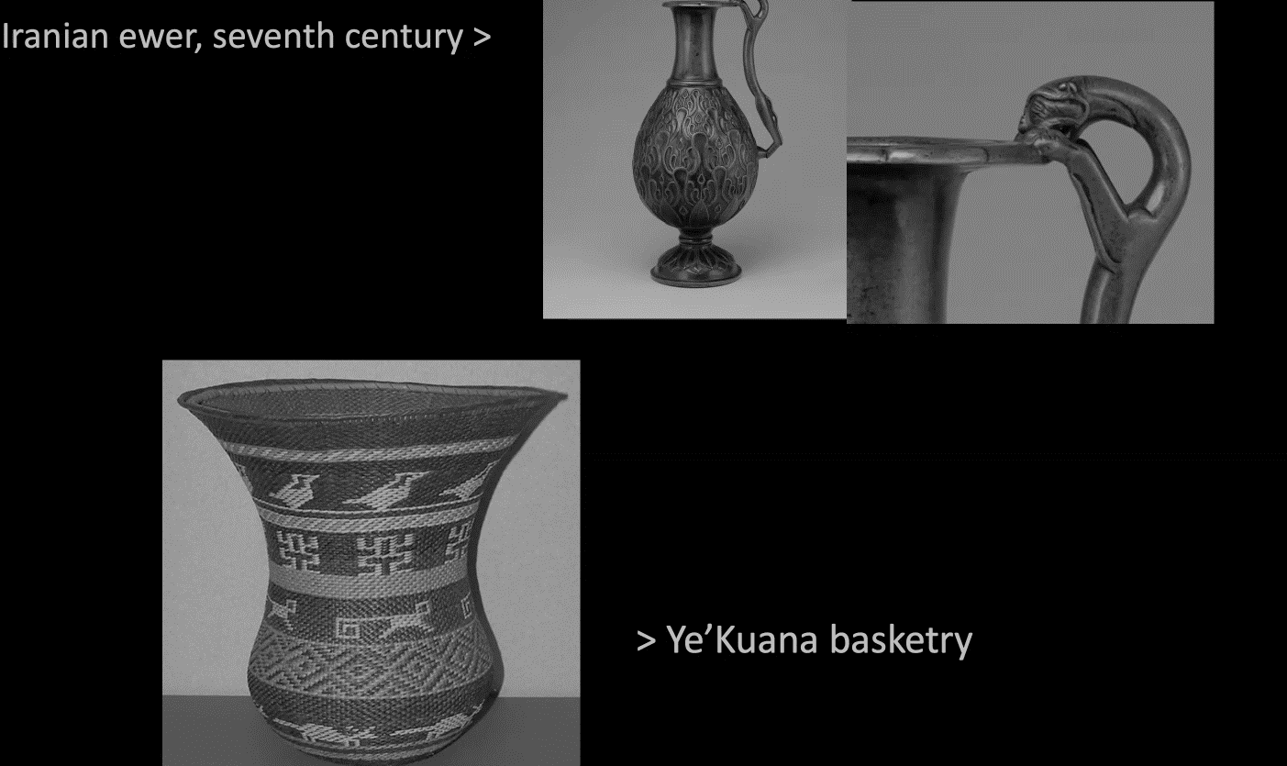
PRESENTATIONS
THE INTERPLAY OF FAMILIAR AND UNFAMILIAR
Fabio Tommy Pellizzer
Patterns of familiarity are embodied in artefacts – we never start from scratch.
Another important concept to be included in the toolbox linking phenomenology to urban morphology: affordances - refractions of possibilities. What things have been for me, for others and what they possibly could or will afford?
Notes:
Fabio Tommy Pellizzer (University of Cologne, Husserl Archives) then succeeded in the unlikely task of providing a preliminary synthesis of many topics that had been touched on before. Focusing on the interplay of the familiar and the unfamiliar, he started out with a discussion of the entanglement of generality and salience to move on to highlight the temporal constitution of typicality and sedimented meaning along the notions of perceiving, remembering, expecting. Crucially, according to him, patterns of familiarity are embodied in artefacts – we never start from scratch. This leads to another important concept to be included in the toolbox linking phenomenology to urban morphology: affordances, understood as refractions of possibilities: what things have been for me, for others and what they possibly could or will afford.

Slide 11

PRESENTATIONS: SPECTRUM
A-TYPICAL SITUATIONS
Gabriella Cianciolo Cosentino
Prisons are among the most highly typified architectural forms, while providing the most exceptional and deliberately un-familiar environments.
Inscription on the prison walls is a habit, contributing to familiarity and feeling at home in a hostile environment designed to control both body and mind.
It has a dual function of transcending existing boundaries and creating new ones. Thus, affordances belong to different layers of existence, ranging from physical to spiritual.
Notes:
Finally, Gabriella Cianciolo Cosentino (University of Cologne) closed the rich panoply of viewpoints with a surprising and unsettling take on the subject. She presented the results of a four-year research project investigating the transformation of prison spaces from different eras through graffiti. The marking of prison spaces with personal, devotional or political inscriptions is an age-old and recurring habit, possibly contributing to some sort of familiarity and feeling at home in a hostile environment designed to control both body and mind.

Slide 12
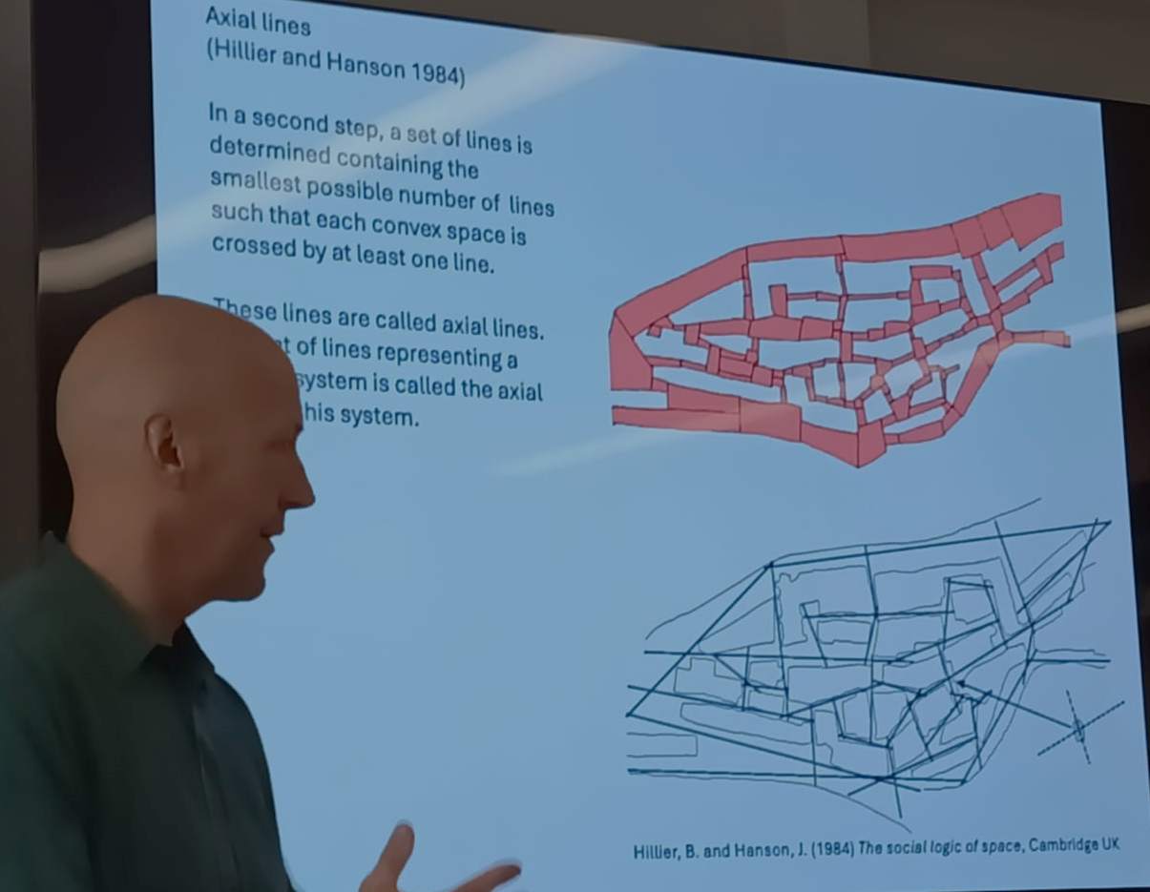
PRESENTATIONS: SPECTRUM
ON TYPICAL STREETS
Urs Primas
Space Syntax addresses urban space in terms of relationships of visibility and movement, to investigate situational types of a central stage of public life: the urban street.
A differentiation of street types according to their situation within a network can then be linked to the evolutionary typification of streets.
The principles of orientation and movement highlighted in phenomenology and the notion of embodied cognition can further enrich the methodological insights of space syntax.
Notes:
Interestingly, there is one strand of urban morphology that explicitly addresses urban space in terms of relationships of visibility and movement. Urs Primas (ZHAW Winterthur) introduced the configurational approach of space syntax to investigate situational types of a central stage of public life: the urban street. Such a differentiation of street types according to their situation within a network can then be linked to the evolutionary typification of streets according to the processes of their formation that had been introduced in urban morphology by Gianfranco Caniggia and Gian-Luigi Maffei.

Slide 13
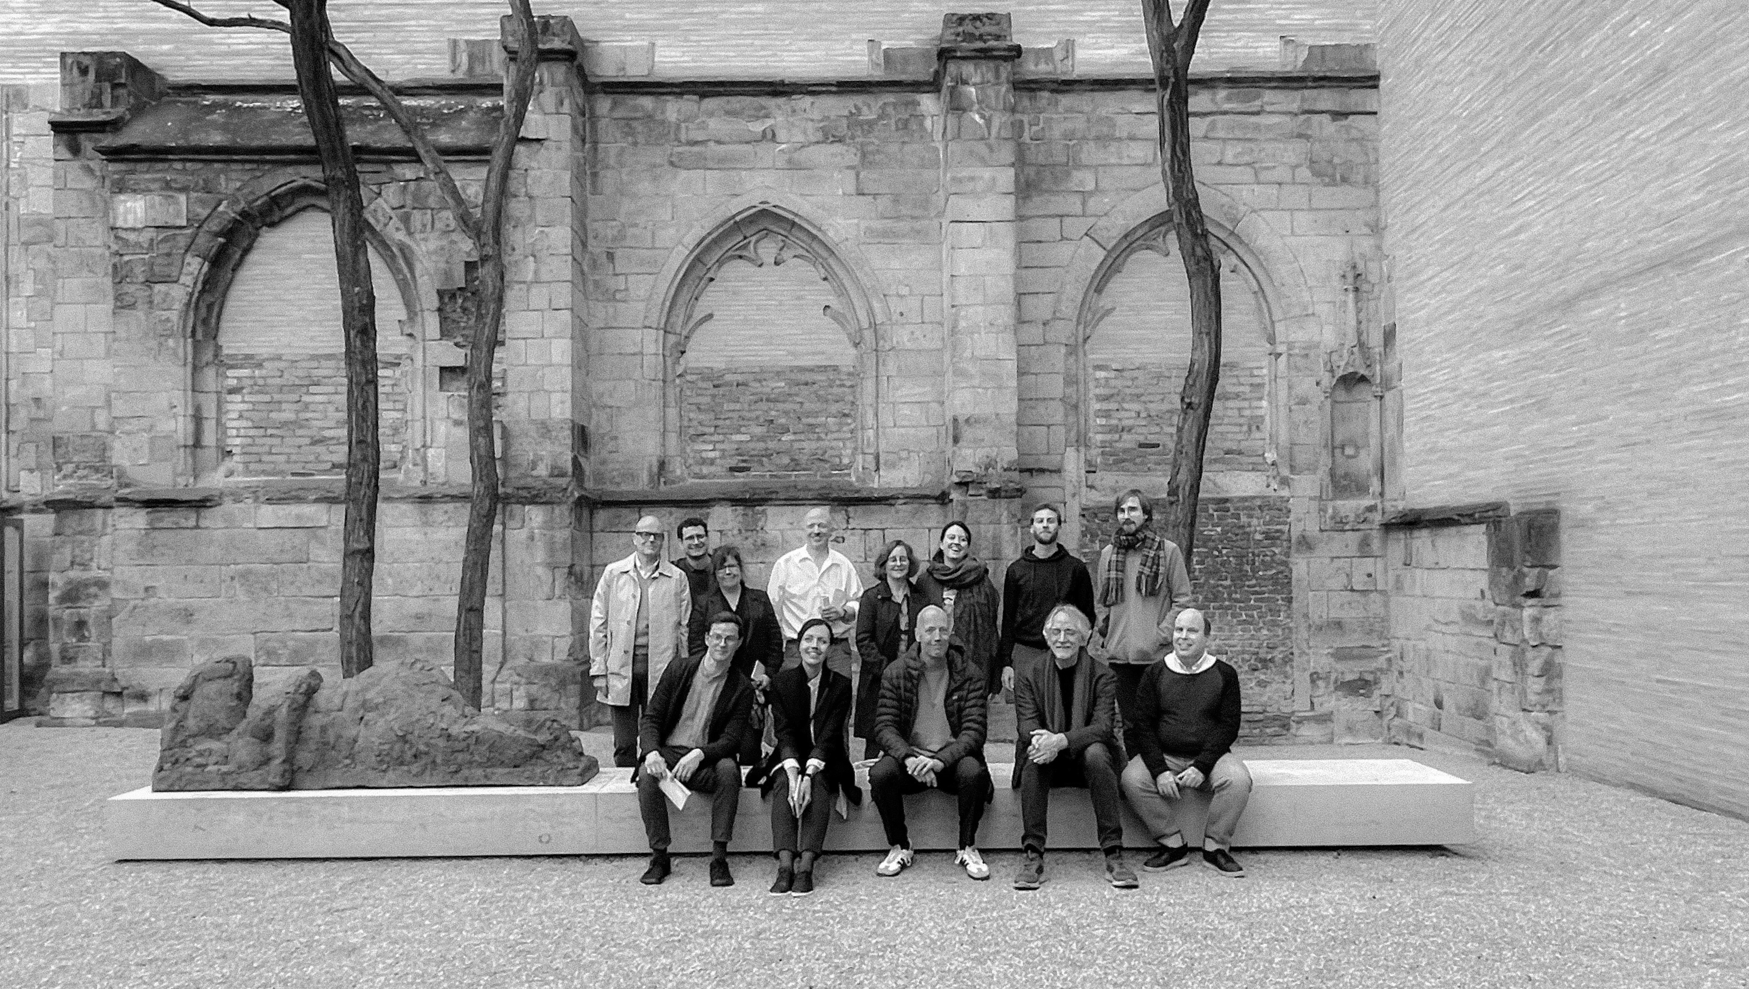
Notes:
The event included several activities that enriched the discussion on the role of typification in human experience and the study of urban form. The various lectures, reflections and discussions were facilitated by a guided tour through a unique place: the Kolumba Museum Cologne. The Kolumba Museum in Cologne is an urban palimpsest that has been in perpetual renewal for some 2,000 years. It was converted into a space for contemplation after the Second World War by Gottfried Böhm and then in 2007 by Peter Zumthor. The varied atmospheres it provides for aesthetic experience interact with the artefacts on display in temporary exhibitions. Kolumba is a veritable laboratory for the phenomenological study of the experience of space.

Slide 14
OUTCOMES
The clarification of typomorphological concepts such as type, process, spontaneous consciousness or territory along insights from Husserlian philosophy may extend the pertinence of morphological concepts and methods beyond the study of physical urban form and lead the way towards a more comprehensive understanding of physical urban form as interlocking with social or cultural form.
Phenomenological approaches that are gaining traction in various areas of social or medical sciences are likely to benefit from the body of knowledge on the spatial structure and the temporal evolution of urban environments that has been accumulated within urban morphology.
Notes:
As a newly constituted team, we aim to develop research with the overarching objective of fostering inter- and transdisciplinary dialogue.
Our goal is to identify methodologies for shaping urban environments in a manner conducive to enhancing the quality of life, well-being and to multi- and transgenerational transfers of meaning.
We will facilitate the dialogue on the transformation of the meaning of place in time, with a view to forming intergenerational environments for the present and future that are respectful of well-being. ‘Typical situations’ is an accepted umbrella term for our future collaborations. The workshop identified a range of terminologies that require clarification and several areas of common interest among the participants that can facilitate the integration of disciplines and methodologies. Generally, a productive connectivity of (Husserlian) phenomenology, enactivism and anthropology with morphological methods such as the typological-processual or Space syntax approaches can be established through the concepts of embodied cognition, familiarity, horizon, habit, and lifeworld.

Slide 15
OUTCOMES
Generally, a productive connectivity of (Husserlian) phenomenology, enactivism and anthropology with morphological methods such as the Typological-processual or Space Syntax approaches can be established through the concepts of embodied cognition, familiarity, horizon, habit, and lifeworld.
As a team, we aim to develop research with the overarching objective of fostering inter- and transdisciplinary dialogue. Our goal is to identify methodologies for shaping urban environments in a manner conducive to enhancing the quality of life, well-being and to multi- and transgenerational transfers of meaning.
We will facilitate the dialogue on the transformation of the meaning of place in time, with a view to forming intergenerational environments for the present and future that are respectful of well-being.
Notes:
As a newly constituted team, we aim to develop research with the overarching objective of fostering inter- and transdisciplinary dialogue.
Our goal is to identify methodologies for shaping urban environments in a manner conducive to enhancing the quality of life, well-being and to multi- and transgenerational transfers of meaning.
We will facilitate the dialogue on the transformation of the meaning of place in time, with a view to forming intergenerational environments for the present and future that are respectful of well-being. ‘Typical situations’ is an accepted umbrella term for our future collaborations. The workshop identified a range of terminologies that require clarification and several areas of common interest among the participants that can facilitate the integration of disciplines and methodologies. Generally, a productive connectivity of (Husserlian) phenomenology, enactivism and anthropology with morphological methods such as the typological-processual or Space syntax approaches can be established through the concepts of embodied cognition, familiarity, horizon, habit, and lifeworld.

Slide 16
FROM TYPES TO MULTIGENERATIONAL ENVIRONMENTS
How do types emerge, and how do they change in time? And how can we build environments that connect different people by means of types?
E.g. Muratori conjectured that each development phase in the emergence of territorial structures goes along with a unique way of translating topographical features into “image concepts”. In his view, these invisible “mental labels” can be reconstructed through an analysis of regularities in landscapes reshaped by human activity (Muratori, 1967, 216). Some approaches have already attempted to go beyond the mere empirical observation and classification of types by postulating mental, social or cultural “templates” (Deetz, 1967, 45) underlying their generation.
Patterns of familiarity are embodied in urban artefacts – we never start from scratch. The bodily-conferred principle of gradual, consistent and continuous space formation, based on traditional bodily habits, advocates a natural integrity of architectural forms and can be related to the typological process and the concept of trusted urban place. Such places deserve careful morphological study, they organise our affective experiences and give form to feelings: This is where congruent social, emotional and urban forms emerge.
Notes:
As a newly constituted team, we aim to develop research with the overarching objective of fostering inter- and transdisciplinary dialogue.
Our goal is to identify methodologies for shaping urban environments in a manner conducive to enhancing the quality of life, well-being and to multi- and transgenerational transfers of meaning.
We will facilitate the dialogue on the transformation of the meaning of place in time, with a view to forming intergenerational environments for the present and future that are respectful of well-being. ‘Typical situations’ is an accepted umbrella term for our future collaborations. The workshop identified a range of terminologies that require clarification and several areas of common interest among the participants that can facilitate the integration of disciplines and methodologies. Generally, a productive connectivity of (Husserlian) phenomenology, enactivism and anthropology with morphological methods such as the typological-processual or Space syntax approaches can be established through the concepts of embodied cognition, familiarity, horizon, habit, and lifeworld.

Slide 17
PERSPECTIVES
Special issue or a glossary: exploring and refining key concepts and methodologies.
The workshop in Pisa “Intergenerational environments and meaning transfer” (10-13 April 2025)
The workshop in Switzerland (January 2026)
The Special issue of the Journal of Architecture and Philosophy (2026)
To further promote dialogue and expand the group a wide variety of potential academic events is intended, such as workshops, conferences, open lecture series, art schools, design studios, and summer schools, which will lead to the joint academic publications.
JOIN US
Notes:
As Thiemo Breyer has put it, through the lens of phenomenology we aim to discern the underlying structure of
perception and cognition that gives rise to our understanding of the typicality of diverse urban landscapes.
Combining phenomenology and urban morphology allows us to go further. The innovative potential of the
framing of this workshop lay in the investigation of the complex interplay between human experience, urban
environment and the nature of typical situations (Husserl), focusing on how they shape our lived experience and
define well-being in urban environments. Types allow for the emergence of legible and coherent urban
environments, contributing to the formation of recognisable urban identities and fostering a sense of place and
belonging. Habitual patterns of use and behaviour also play a crucial role in sharpening the usability of
architectural spaces. Buildings contain elements that facilitate and support habitual activities, such as intuitive
wayfinding systems and efficient circulation patterns. The concept of habit extends to the wider urban context,
where the layout and configuration of streets and neighbourhoods influence daily routines and the relationship
between rationality and experience. By aligning architectural design with habitual behaviour and routine,
architects and urban designers may enhance the user’s experience of the built environment.

Slide 18
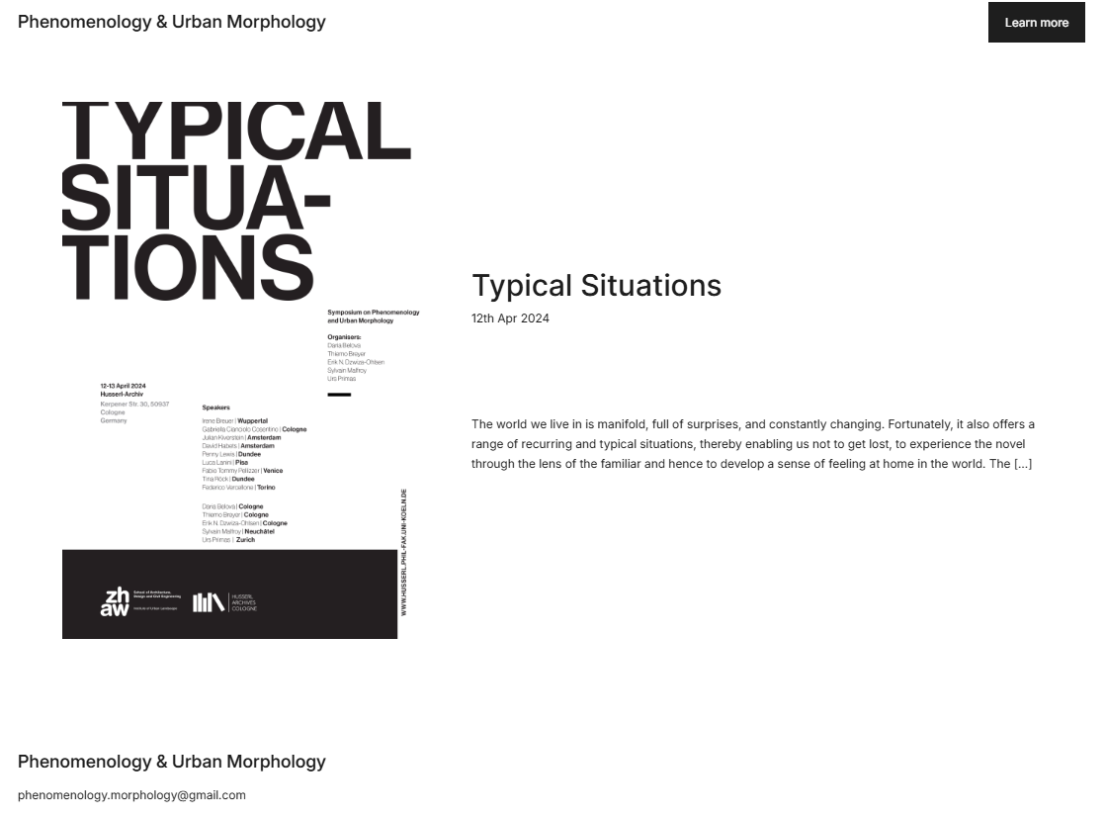
FOLLOW US: PHENO-MORPHOLOGY.COM

Slide 19
THANK YOU!
INTERNATIONAL SEMINAR ON URBAN FORM

